Slide 1
renewind PROJECT
COURSE TITLE: MODEL TUNING
DATE: JULY 22nd, 2022

Slide 2
Contents
Business Problem Overview & solution approach
Data overview
Exploratory Data Analysis (EDA)
Data Preprocessing
Model performance summary
Model building with pipeline
Appendix
Business Insights and Recommendations

Slide 3
BUSINESS PROBLEM OVERVIEW & SOLUTION APPROACH
Renewable energy sources play an important role in the global energy mix, as the effort to reduce the environmental impact of energy production increases.
Wind energy is one of the most developed technologies worldwide and the U.S Department of Energy has put together a guide to achieving operational efficiency using predictive maintenance practices.
Predictive maintenance means failure patterns are predictable and if component failure can be predicted accurately and the component is replaced before it fails, the costs of operation and maintenance will be much lower.
Predictive maintenance uses sensor information related to various environmental factors (temperature, humidity, wind speed, etc.) and additional features related to various parts of the wind turbine (gearbox, tower, blades, break, etc.) to measure and predict degradation and future component capability.
ReneWind is a company working on improving the machinery/processes involved in the production of wind energy using machine learning and has collected data of generator failure of wind turbines using sensors.
They have shared a ciphered version of the data, as the data collected through sensors is confidential (the type of data collected varies with companies). Data has 40 predictors, 20000 observations in the training set and 5000 in the test set.
The objective is to build various classification models, tune them, and find the best one that will help identify failures so that the generators could be repaired before failing/breaking to reduce the overall maintenance cost.

Slide 4
DATA OVERVIEW
The data is divided into two, the train and test set
The train set consist of 20,000 rows, 41 columns
The test set consist of 5,000 rows, 41 columns
The data set consist of 40 predictor variable and 1 target variable
The target variable has two unique numbers 0 & 1, identifying as not failure and failure respectively
The train data for target variable had the following distribution
A total of 18890 machines in good condition
a total of 1110 failure which means it needs repair before breaking down
The test data for target variable had the following distribution
A total of 4718 machines in good condition
a total of 282 failure which means it needs repair before breaking down

Slide 5
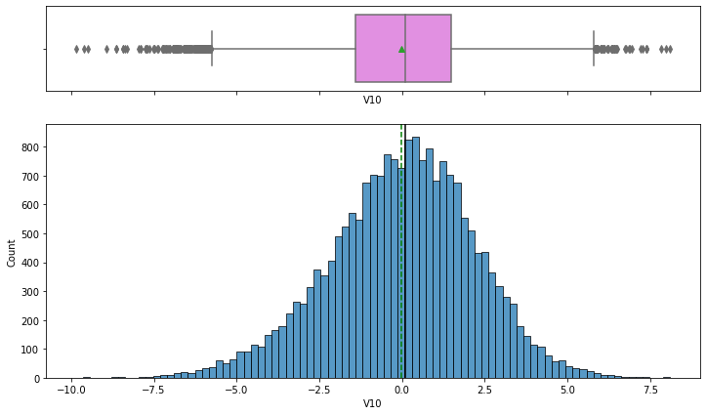
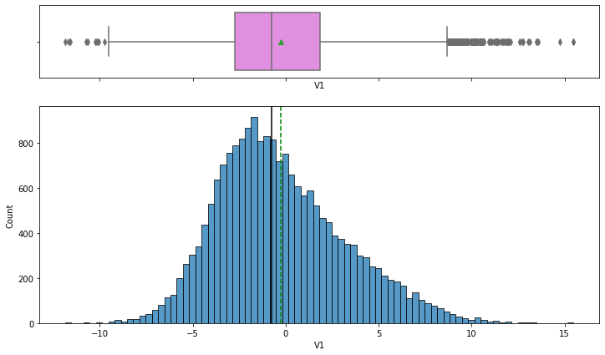
EXPLORATORY DATA ANALYSIS(EDA)
The average V1 predictor variable is higher than the median for V1 predictor variable indicating the distribution is skewed to the right
The V1 predictor variable is distributed between -10 to 15
there are outliers in the distribution
The average V10 predictor is almost the same with the median V10 predictor indicating the median is nearly symmetrical
The V10 predictor variable is almost evenly distributed between -7.5 to 7.5
there are outliers in the distribution

Slide 6
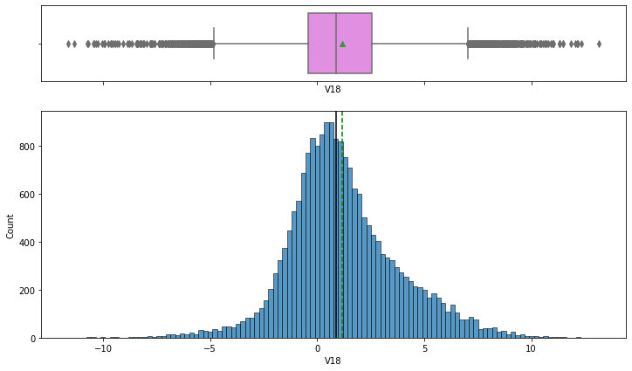
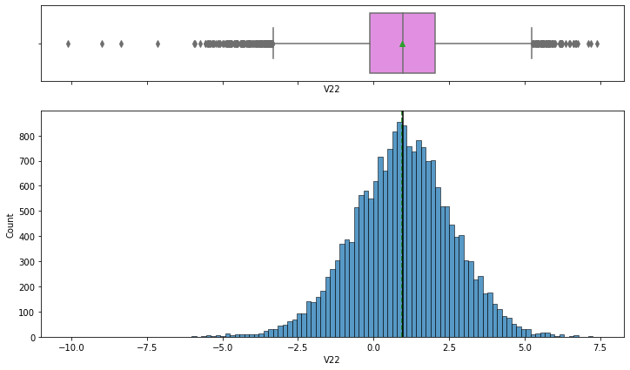
EXPLORATORY DATA ANALYSIS(EDA)
The average V18 predictor variable is higher than the median for V18 predictor variable indicating the distribution is skewed to the right
The V1 predictor variable is almost evenly distributed between -10 to 10
there are outliers in the distribution
The average V22 predictor is the same with the median V22 predictor indicating the median is symmetrical
there are outliers in the distribution

Slide 7
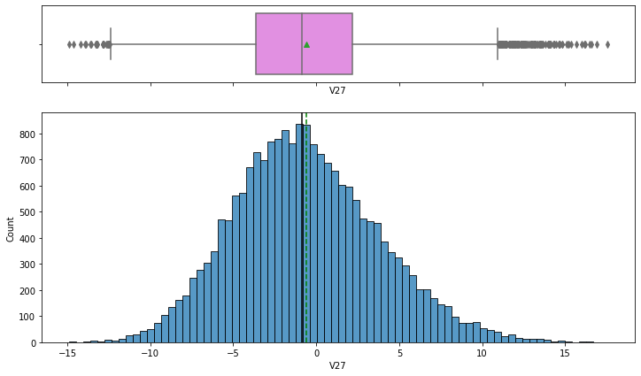
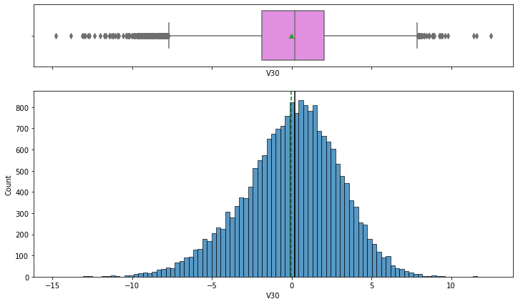
EXPLORATORY DATA ANALYSIS(EDA)
The average V27 predictor variable is higher than the median for V27 predictor variable indicating the distribution is slightly skewed to the right
there are outliers in the distribution
The average V30 predictor variable is lower than the median for V30 predictor variable indicating the distribution is skewed to the left
there are outliers in the distribution

Slide 8
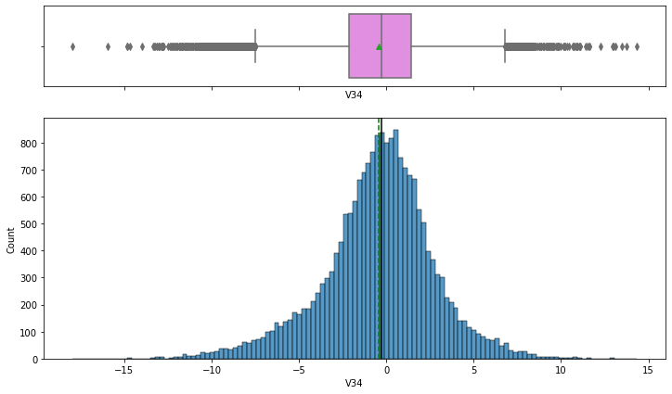
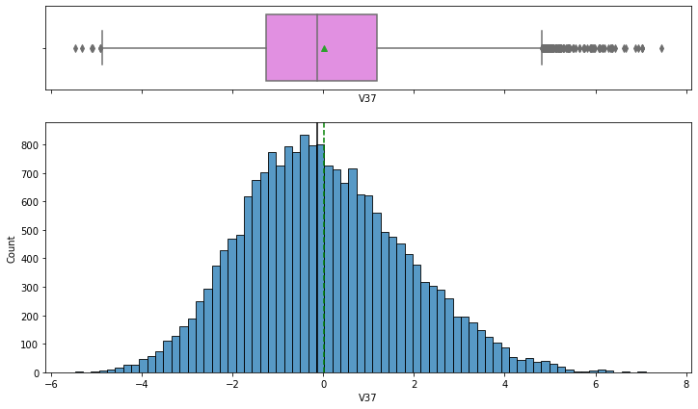
EXPLORATORY DATA ANALYSIS(EDA)
The average V34 predictor variable is almost the same to the median for V34 predictor variable indicating the distribution is nearly symmetrical
The V1 predictor variable is almost evenly distributed between -7.5 to 7.5
there are outliers in the distribution
The average V37 predictor variable is higher than the median for V37 predictor variable indicating the distribution is skewed to the right
there are outliers in the distribution

Slide 9
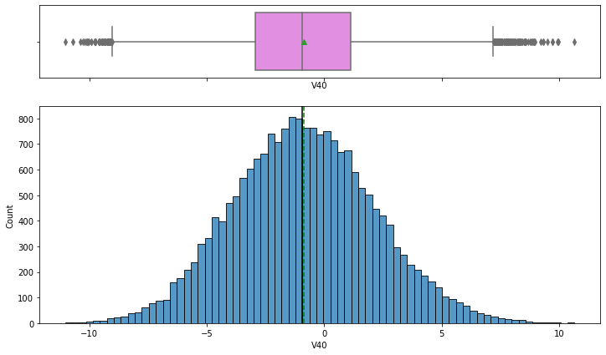
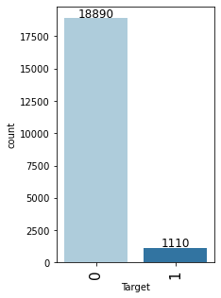
EXPLORATORY DATA ANALYSIS(EDA)
The average V40 predictor variable is almost the same to the median for V40 predictor variable indicating the distribution is nearly symmetrical
The V40 predictor variable is almost evenly distributed between -10 to 10
there are outliers in the distribution
The target variable shows 18890 predictor are in good condition
The distribution predicts 1110 predictors need repair

Slide 10
DATA PREPROCESSING
There are no duplicates in the data set
There are missing value in both the train and test data indication predictor V1 and V2 with missing value
• The data preparation will be used to build various classification models, tune them, and find the best one that will help identify failures so that the generators could be repaired before failing/breaking to reduce the overall maintenance cost

Slide 11
Model Performance summary
To build various classification models, tune them, and find the best one that will help identify failures so that the generators could be repaired before failing/breaking to reduce the overall maintenance cost
• Recall will be used as performance metric of evaluation,
A high recall means failures correctly predicted by the model. These will result in repairing costs.
The lower the recall means real failures where there is no detection by the model. These will result in replacement costs.
- False positives (FP) are detections where there is no failure. These will result in inspection costs.
• the greater the Recall, the higher the chances of minimizing false negatives.
• The most significant predictors variable to identify failure
• V30
V9
V18
V12
V36
V3

Slide 12
Model Performance summary
MODEL | TRAIN ACCURACY | VALIDATION ACCURACY | TRAIN RECALL | VALIDATION RECALL | TRAIN PRECISION | VALIDATION PRECISION | TRAIN F1 | VALIDATION F1
Gradient Boosting tuned with oversampled data | 0.99 | 0.97 | 0.99 | 0.84 | 0.99 | 0.69 | 0.99 | 0.76
AdaBoost classifier tuned with oversampled data | 0.99 | 0.97 | 0.98 | 0.85 | 0.99 | 0.79 | 0.99 | 0.82
Random forest tuned with undersampled data | 0.96 | 0.93 | 0.93 | 0.88 | 0.98 | 0.46 | 0.96 | 0.61

Slide 13
Model Building with Pipeline
Steps taken to create a pipeline for the final model
Create pipeline with the best model which was adaboost classifier tuned with oversampled data
Next, separate target variable and other variables into independent variable and target for train data
We can't oversample/undersample data without doing missing value treatment, so first, we have to treat missing values in the train and test sets.
Oversample/undersample the train data and create necessary variables for them (if needed)
Fit the model on train data
Check the performance on test set
The performance of the model built with pipeline on the test dataset
The test recall is 79% which is low compared to the precision which is 98%, this cant fully predict failures and can lead to maximizing replacement cost. This is not a great model to predict failures
The most important factors used by the model built with pipeline for prediction are;
V30,V9, & V18.

Slide 14
MODEL PERFORMANCE SUMMARY (original data)
We can see that the xgboost is giving the highest cross-validated recall followed by random forest and bagging
The boxplot shows that the performance of xgboost, random forest and bagging is consistent and their performance on the validation set is also good
Model | Cross validation cost | Validation performance
Logistic regression | 0.49 | 0.48
Bagging | 0.72 | 0.73
Random forest | 0.72 | 0.72
Gradient boost | 0.70 | 0.72
Adaboost | 0.63 | 0.67
Xgboost | 0.79 | 0.82

Slide 15
MODEL PERFORMANCE SUMMARY (oversampled data) we chose the random search cv for the oversampling method for gradient boost and ada boost classifier. The gradient boost and adaboost classifier did not have the highest recall in both the cross validation and validation set. After hyper tuning the data there was a general performance increase which made it a better option in predicting failures with the highest recall
MODEL | TRAIN ACCURACY | VALIDATION ACCURACY | TRAIN RECALL | VALIDATION RECALL | TRAIN PRECISION | VALIDATION PRECISION | TRAIN F1 | VALIDATION F1
Gradient Boosting tuned with oversampled data | 0.99 | 0.97 | 0.99 | 0.84 | 0.99 | 0.69 | 0.99 | 0.76
AdaBoost classifier tuned with oversampled data | 0.99 | 0.97 | 0.98 | 0.85 | 0.99 | 0.79 | 0.99 | 0.82

Slide 16
MODEL PERFORMANCE SUMMARY (undersampled data) we chose the random search cv for the undersampling method for random forest. The random forest performed well in the original data for both the cross validation cost and validation performance. After hyper tuning the data the training the performance improved but validation precision was very low and it also gave the highest recall.
MODEL | TRAIN ACCURACY | VALIDATION ACCURACY | TRAIN RECALL | VALIDATION RECALL | TRAIN PRECISION | VALIDATION PRECISION | TRAIN F1 | VALIDATION F1
Random forest tuned with undersampled data | 0.96 | 0.93 | 0.93 | 0.88 | 0.98 | 0.46 | 0.96 | 0.61

Slide 17
BUSINESS INSIGHTS AND conclusion
The following are the insights the data displayed
The logistic regression shows performance with oversampled data on training set varies between 0.83 to 0.86 recall
The logistic regression shows performance with oversampled data on training set varies between 0.86 to 0.88 recall
The following will be recommended for RENEWIND;
The best model to help identify failures so that the generators could be repaired before failing/breaking to reduce the overall maintenance cost will be the Adaboost classifier tuned with oversampled data, Which presents the best recall of 85% with overall good performance across all set and this will help minimize false negatives.

